Slide 1


Functional programming in concurrent and distributed systems
381-1-0112 | SM B 2021 | Tutorial 9
By Yeh’iel Zohar and David Leon

Slide 2

Outline
Motivation
ETS Tables
Sorting
Ownership and Permissions
Operations
Examples
Submission Procedures

Slide 3
#1 Motivation
How we stored information until now?
Local data (function arguments, variables)
Registration (PIDs)
Process dictionary
Mailboxes
etc.
What we missed by using these tools?
Share data with other processes
Keep data upon a failure of a process
Constant access time (vs. logarithmic access time)
Parallel access (vs. sequential non-scalable access)
Store large mounts of data.
ETS

Slide 4
#2 ETS Tables
Erlang Term Storage tables
Efficient in-memory database included with the Erlang VM
Located in the VM where destructive updates are allowed
No garbage is collected
ETS is accessible using the ets module
ETS concepts
Limited concurrency in reads and writes is allowed
ETS tables natively store Erlang tuples containing anything
One of the tuple elements acts as a primary key that is used to sort things
Different ways to store data into tables
ETS table is owned by the process that started it.
The Ets is intimately linked to the process, if process die the table is vanished.

Slide 5
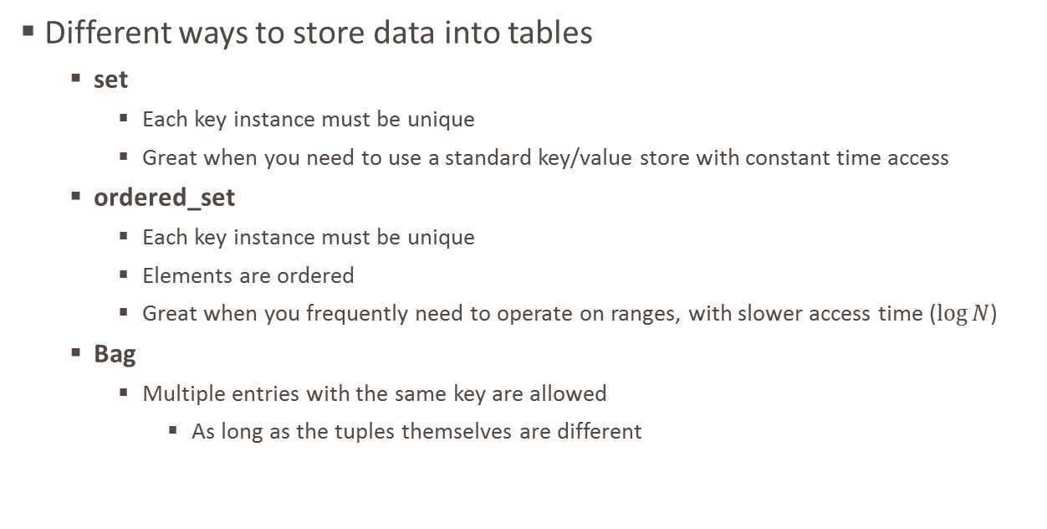
#2.1 ETS Tables: Sorting
Different ways to store data into tables
set
Each key instance must be unique
Great when you need to use a standard key/value store with constant time access
ordered_set
Each key instance must be unique
Elements are ordered
Great when you frequently need to operate on ranges, with slower access time ($\log{N}$)
Bag
Multiple entries with the same key are allowed
As long as the tuples themselves are different

Slide 6
#2.2 ETS Tables: Ownership and Permissions
When a process calls a function that starts a new ETS table, that process is the owner of the table
If the process dies, the table disappears, and so does all of its content
However, the table can be given away
A new ETS table is granted the protected level of permissions
protected: only the owner can write to it, but everyone can read from it
public: everyone can read and write
private: only the owner can read or write

Slide 7
#2.3 ETS Tables: Operations
ets:new(Name, Options)
Starts a new ETS table
Takes the argument Name and then a list of Options
Returns a unique identifier
comparable to a PID for processes
Options (next slide)

Slide 8
#2.3 ETS Tables: Operations
Options
Type set | ordered_set | bag | duplicate_bag
Access private | protected | public
named_table used to contact the table using its Name
{keypos, Position}
an integer telling which of each tuple's element shall act as the primary key
The default key position is set to 1.
Be carefull when storing records in ETS, in their tuple form in case of default key the record name will act as the key (and we don’t want that most of the time!).

Slide 9
#2.3 ETS Tables: Operations
Options
{heir, Pid, Data}
The table is automatically inherited by the defined heir when the ets’ parent process is dead. The heir process will receive the following message: {'ETS-TRANSFER', TableId, FromPid, Data}
Data is the element passed when the option was first defined.
{read_concurrency, true | false}
optimize the table for read concurrency.
should be enabled when you do a lot of reading and little writing.
{write_concurrency, true | false}
Usually, writing to a table will lock the table to rest read/write accesses.
Setting this option to 'true' lets both reads and writes be done concurrently
compressed
It is possible to define or change options in later point with ets:setopts/2.
A table can be given away with ets:give_away/3

Slide 10
#2.3 ETS Tables: Operations
ets:insert(Tab, ObjectOrObjects)
Inserts the object or all of the objects in the list ObjectOrObjects into the table Tab
The entire operation is guaranteed to be atomic and isolated
ets:lookup(Tab, Key)
Returns a list of all objects with the key Key in the table Tab
ets:delete(Tab)
Deletes the ETS table Tab
ets:delete(Tab, Key)
Deletes the entry indexed by Key from table Tab
Many other optional actions are available, visit the ets module!

Slide 11
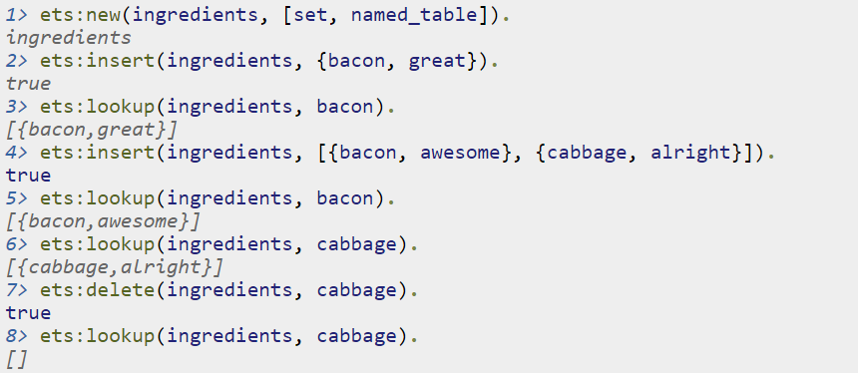
#2.4 ETS Tables: Example 1

Slide 12
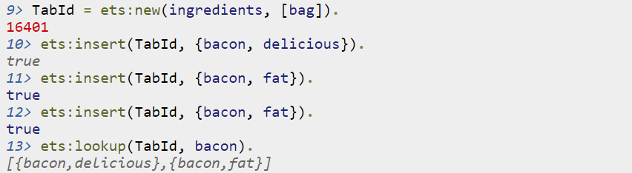
#2.4 ETS Tables: Example 2

Slide 13
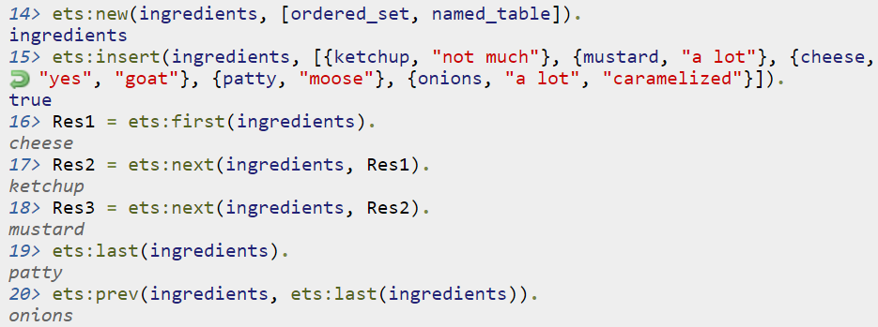

#2.4 ETS Tables: Example 3

Slide 14
#3 Submission Procedures (Optional - Bonus)
Only a single .erl file to be submitted
Filename format: ex9_<ID>.erl
Where <ID> needs to be replaced with your ID number
Your code MUST be well documented
Functions’ names must be identical to the ones defined in exercise
Same as for the arity
Same as for the output format
Only the tested functions needs to be exported
Internal functions MUST NOT be exported
Assignments will be tested automatically in using Erlang shell in Linux
No excuses

Slide 15
Exercise 9 (Optional - Bonus)
etsBot()
Executes a series of actions in a ETS table
Reads the list of actions to execute from a file named “etsCommands.txt”
Actions are separated by newline characters, fields are separated by blank spaces
Actions
Insert key insert <key1> <value1> <key2> <value2> …
No update should be performed in the ETS table!
Update key update <key1> <newValue1> <key2> <newValue2> …
No insertion should be performed in the ETS table!
Delete key delete <key1> <key2> …
If key doesn’t exist, ignore its deletion
Lookup key lookup <key1> <key2> …
Prints “key: <key1> val: <val1>” to screen upon every lookup
If key doesn’t exist, ignore its lookup

Slide 16
Exercise 9
etsBot()
Executes a series of actions in a ETS table
Reads the list of actions to execute from a file named “etsCommands.txt”
The first line of the input file defines the characteristics of the ETS table
Ordering (one of the following): set | ordered_set | bag
Writes the contents of the ETS table into a file named “etsRes_<ID>.ets”
<ID> field is to be replaced by the student’s ID number
Each line represents an entry in the format <key> <value>

Slide 17
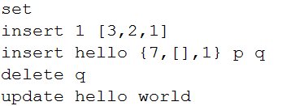

Exercise 9
etsBot()
Example
“etsCommands.txt”
“etsRes_123456879.ets”

